Slide 1
WoNBias: A Dataset for Classifying Bias &
Prejudice Against Women in Bengali Text
1
Supervised by
Dr. Mohammad Shahidur Rahman
(Professor, CSE, SUST)
Partha Protim Paul
(Lecturer, IICT, SUST)
Submitted by
MD. Raisul Islam Aupi
201883005
Nishat Tafannum
2018831029

Slide 2
Outline
2
__________________
___________________
Objective
Inspiration Behind
Our Proposed Path
Methodology
Collected and Annotated Dataset Statistics
Result & Comparison
Limitations & Future Directions
Conclusion

Slide 3
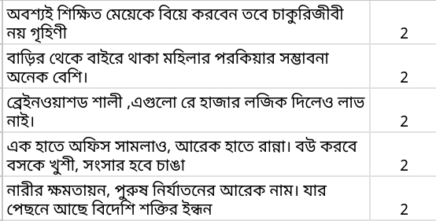
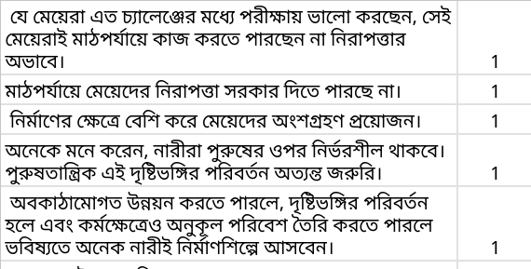
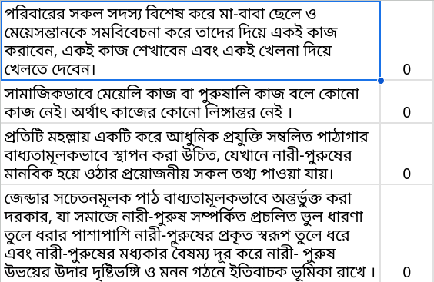
Objective
Positive
Neutral
Negative
__________________
3
__________________
Creating a complete Bengali dataset that encompasses a variety of stereotyping, hateful or discouraging comments, and ideologies toward women
__________________
__________________
__________________

Slide 4
Inspiration Behind
_______________________________
_______________________________
4
Elevating Bengali AI: Integrating Gender Fairness Efforts Toward Women in Large Language Model Development In Bengali
Ensuring Responsible Speech: Addressing Content Moderation Challenges in the Bengali Language Landscape
Dealing with Existing Large Language Models Struggle with Bias Detection, Particularly Against Women, in Bengali Text
Give the Initiative to prevent bias against women a boost

Slide 5
Our Proposed Path
_______________________________
_______________________________
5
There have already been study on
Gender Bias
Ethnic Bias
Religion Bias
Cultural Bias
But almost all of them covers only the English-speaking demography and there exists few to none for the Bengali-speaking demography.

Slide 6
Our Proposed Path
_______________________________
_______________________________
6
Our initiative directly addresses this gap by creating a complete dataset for detecting bias and prejudice against women in Bengali Text.
Train a classification model for this purpose and compare it to existing capability for detecting such bias by real world applications

Slide 7
Methodology
Data Collection Process :
___________________________
_______________________________
7
Participants
Online Survey
Group Sessions
Other Sources
Online Posts and Comments From Different Social Sites
Blog Sites
Newspaper Articles
Existing Datasets on Bengali-paraphrase.

Slide 8
Methodology
Data Quality Management :
___________________________
_______________________________
8
High-Quality Annotations
Filtering Data
Representation and Diversity
Consistency

Slide 9
Methodology
Identifying Model to Train :
Identifying model for comparison :
___________________________
_______________________________
9
cse-buetnlp/banglabert's Sequence Classification
Model for Double Sequence Classification
The GPT-3.5-turbo model

Slide 10
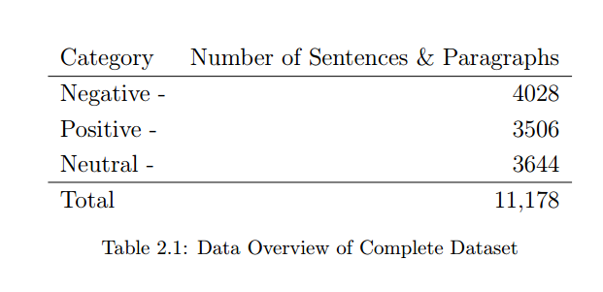
Collected and Annotated Dataset Statistics
_______________________________________________________________________
10
_________________________________________________________________________

Slide 11
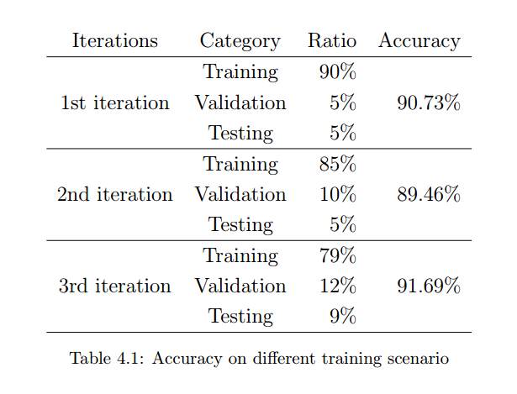
Result & Comparison
___________________________________
11
____________________________________
Hyperparameter | Value
Epochs | 20
Batch Size | 64
Max Length | 80

Slide 12
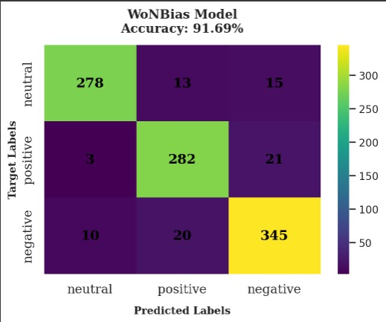
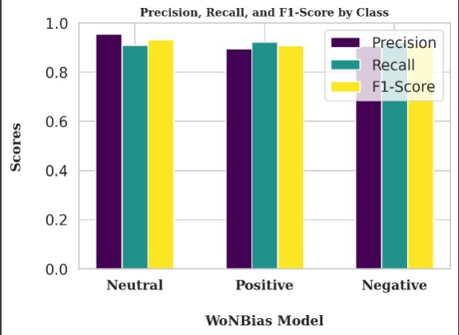
Result & Comparison
Best Performance for WoNBias Model
___________________________________
12
____________________________________

Slide 13
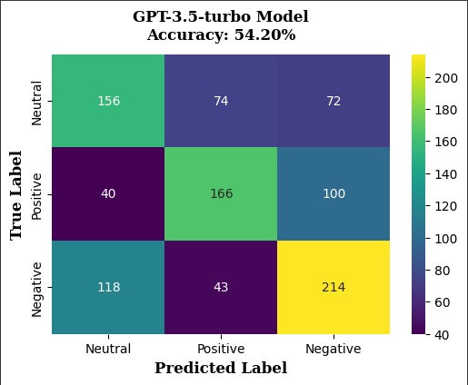
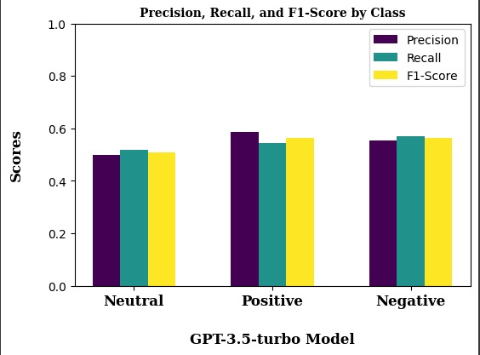
Result & Comparison
Performance for GPT-3.5-turbo Model
___________________________________
13
____________________________________

Slide 14
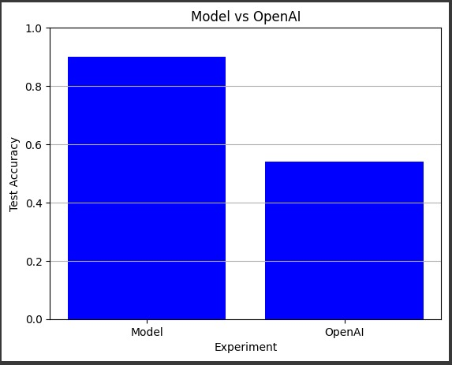
Result & Comparison
Performance Comparison
___________________________________
14
____________________________________

Slide 15
Result & Comparison
Lackings of GPT-3.5-turbo Model :
___________________________________
15
____________________________________
Failure to Understand Bengali syntax and language semantics
Very Low Understanding of Patterns for Detecting Positive, Negative or Neutral Sentences

Slide 16
Limitations & Future Directions
________________________________________________
16
__________________________________________________
Exhaustive Approach Limited Dataset Growth
Needs Explicit Context
Unable to Detect All Kinds of Terms or Nouns that Indicates Woman

Slide 17
Limitations & Future Directions
________________________________________________
17
__________________________________________________
Grow The Existing Dataset to More than 20,000
Train with Larger Sentences and Paragraphs
Introduce More Feminine Names and Indicative Nouns & Pronouns
Train & Test after Introducing Data with More Noise
Set comparison with More Real World Application

Slide 18
Conclusion
___________________________________
18
____________________________________
Our work suggests the overall viability of our work for primarily in dataset or content filtering and content moderation on any social platform.
Its higher level use can be for universal large language model training for eliminating these kinds of bias in Bengali text generation.

Slide 19
19
Thank You

